Slide 1
Project Presentation
Custom-Built AML Engine for Transaction Risk Evaluation
Olalekan Ade-Ojo
29-07-2025

Slide 2
Background of Project
AML compliance is a regulatory requirement across the financial sector, from banks to investment companies, etc.
Old practice involves manual reviews of transactions which are prone to error, delays, and inconsistent judgment and excessive use of manual labor which is not cost effective.
There is a gap in the market for the need of real-time, rule-driven, analysis conducting mechanism which is main point of modern AML system development.

Slide 3
Aims of the project
To Develop an intelligent AML engine that:
– Ingests and evaluates financial transactions
– Applies configurable rules for violations
– Scores the risk level based on defined criteria
– Generates alerts for suspicious activity

Slide 4
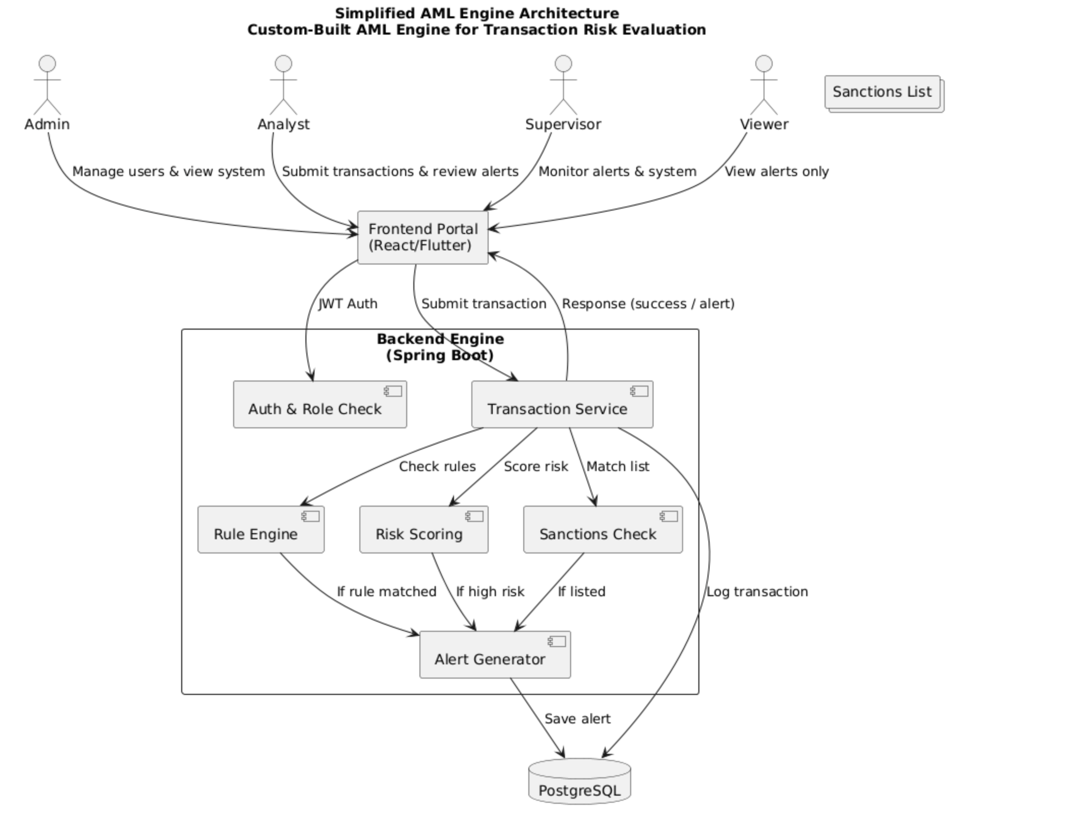
System Architecture

Slide 5

Functional Requirements
• Transaction Ingestion:
– Accepts transaction data via portal upload or API
• Rule Evaluation:
– Matches transactions against defined AML rules (JSON-based)
• Risk Scoring:
– Calculates weighted risk score based on transaction attributes
• Alert Generation:
– Flags suspicious activity and logs alerts in the database
• Sanctions Screening:
– Matches names and countries against local sanction list
• Role-Based Access:
– Admin, Analyst, Supervisor, and Viewer – each with distinct access
• Alert Review:
– Analysts and Supervisors can view and investigate flagged alerts
• Logging & Audit Trail:
– Logs all sensitive actions for security and compliance

Slide 6
Theoretical Background
Architecture
Microservices-based modular design (aml-admin, aml-pojo, aml-common and aml-portal)
Aml-admin : Core backend logic and business services
Aml-pojo: Shared domain models and data structures
Aml-common: Utility and shared functionality module
Aml-portal: Front-facing REST API and user interaction layer
Full-stack AML solution for transaction monitoring and compliance

Slide 7
System Design – Components
• Spring Boot (Java): Backend service for rule processing and alert generation
• PostgreSQL: Stores transactions, alerts, and risk scores
• React Portal: User interface for submitting transactions and reviewing alerts
• JWT Security: Role-based access control for Admin, Analyst, Viewer and supervisor
• Rule Config JSON: Allows dynamic, reloadable rule configurations
• Docker: Deployment support for backend and portal services

Slide 8
Backend Technologies
External Integrations:
OFAC SDN List API (Temporarily disabled due to connection error & basically it prevents alert generation if breaks)probably cause it’s free
Currency Conversion APIs
Twelve Data API (financial markets)
For Testing: JUnit 5, Spring Boot Test, Mockito

Slide 9
Frontend Technologies
Core: React 18.x, React Router DOM, React Redux Toolkit
Build Tools: Vite, Babel, ESLint, Prettier
UI: Material-UI (MUI), MUI Icons, Recharts
State Management: Redux Toolkit, Redux Persist
HTTP Client: Axios, jwt-decode
Data Utilities: PapaParse (CSV), date-fns
Testing: Vitest
Runtime: Node.js, npm

Slide 10
Data Storage & Formats
Data Storage & Formats
Primary DB/Test: PostgreSQL (via pg4admin)
Data Formats: JSON (API), CSV (import/export), XML (OFAC data)
Security
Auth: Spring Security, JWT, RBAC
Data Protection: HTTPS, CORS, input validation

Slide 11
Deployment & DevOps
Platform: Render (cloud deployment)
Containerization: Docker, Docker Compose
Automatic Github push to deploy on render
Development Tools
IDEs: IntelliJ IDEA (Java), VS Code (React)
Quality: JUnit, Vitest, ESLint, Prettier

Slide 12
Design
In terms of how the project is structured, it uses a Maven setup with microservices 4 major modules. Most of the core logic is in the aml-admin module. That’s where the main engine runs; rule matching, risk scoring, and alert generation.
Some of it’s key classes include:
AMLEngine.java, which takes in the transaction and decides what to do with it
RiskScoringServiceImpl, which calculates a score based on amount, origin, etc.
And AlertRepository, which writes alerts to PostgreSQL.
I added security using Spring Security with JWT, so roles like admin and analyst are clearly separated.
Testing was done with JUnit and integration tests. I wrote edge cases — like high-risk transactions, known sanctions, and repeated patterns — to make sure the engine flags what it’s supposed to.”

Slide 13
System Architecture
Action/Roles | Admin | Analyst | Supervisor | Viewer
View Alerts | Access | access | access | access
View Dashboard | Access | access | access | access
Modify Alerts | Access | access | denied | denied
Export Alerts | Access | denied | access | denied
System Settings | Access | denied | denied | denied

Slide 14
System Structure
Users interact through the portal.
The engine takes in the transaction, runs it through a rule checker, and calculates a risk score.
If it matches a flagged condition, it creates an alert.
All of this is stored in PostgreSQL, which can be reviewed by an analyst.

Slide 15
Main Algorithms Used
Risk Score Evaluation
Each transaction is scored based on known risk factors:
Risk_Score = A + C + F + M
Where:
A = 25 if amount > $100,000, else 0
C = 25 if country is high-risk, else 0
F = 25 if sender is frequently flagged, else 0
M = 25 if manually flagged, else 0
So, 0 ≤ Risk_Score ≤ 100….. If any rule returns true, then it’s a match.

Slide 16
Main Algorithms Used
Alert Decision
An alert is triggered if:
(Risk_Score ≥ 50) ∨ Match = true ∨ Sanctioned = true
Suppression Logic & Cooldown Logic
Before creating an alert, we check:
Duplicate = (Same sender + reason + time window)
Cooldown Active
Cooldown = (Same sender & rule triggered recently)
If either is true, suppress the alert.

Slide 17
Code and Testing
• Main classes:
AMLEngine.java: core transaction evaluation logic
RiskScoringServiceImpl.java: calculates scores from rule matches
AlertRepository.java: handles alert storage in PostgreSQL
RuleLoader.java: loads dynamic rule config from JSON
JwtAuthFilter.java: role-based access security (Admin, Analyst, Viewer)
Testing:
Used JUnit for unit tests and after deployment testing
Manual integration testing with test transaction data
Tested alert accuracy, false positives, risk calculations

Slide 18
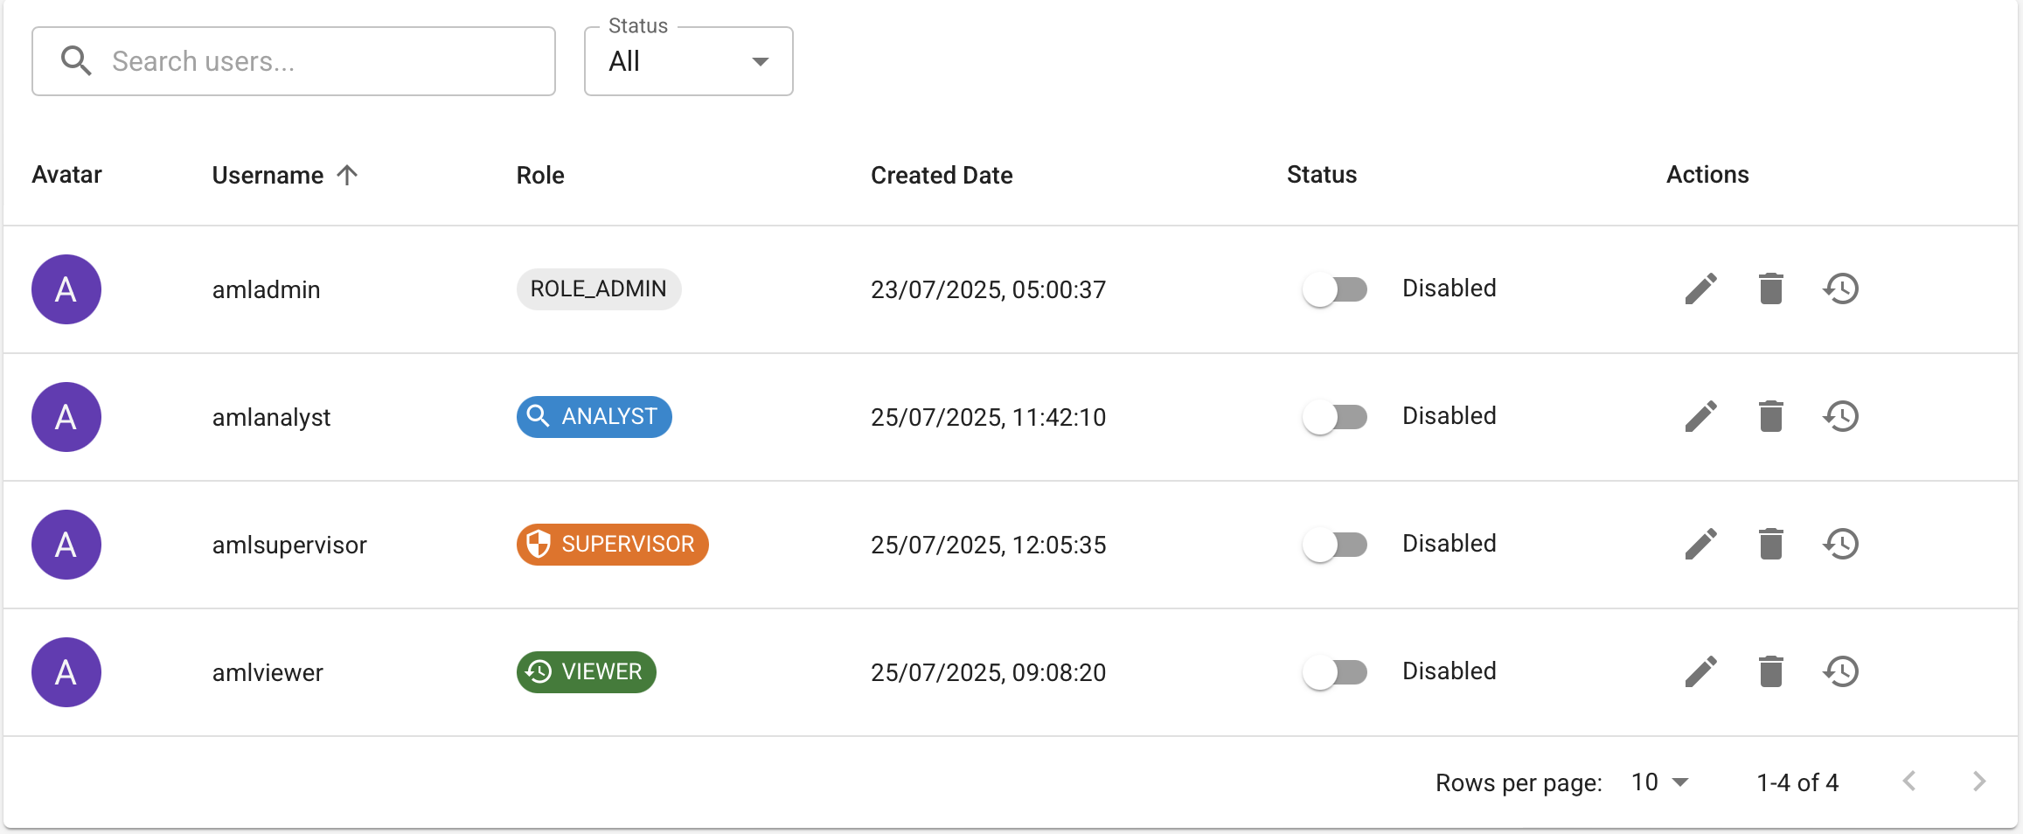
GUI Layout
– Role-based interface (Admin, Analyst, Viewer and supervisor)
– View alerts, upload transactions, manage users, display live stock market data and currency converter
– Clean dashboard for reviewing high-risk activity

Slide 19
Evaluation
System tested end-to-end: ingestion → rule matching → alert generation
Used real-world style test data from /test-data directory and real sanctioned individuals including Russian oligarchs, terrorist sponsoring government leaders, e.t.c
Backend tested with JUnit (Spring Boot), Frontend with React test suite
Role-based access tested with JWT-authenticated users
Evaluation focused on:
– Rule accuracy
– Risk scoring validity
– Alert generation reliability
• System passed all basic functional checks and is production-ready

Slide 20
Advantages and Limitations
Real-time transaction analysis and alerting
Dynamic, JSON-based rule engine (no redeploy required)
Clean, role-based UI (Admin, Analyst, Viewer)
Modular design – scalable and maintainable
Fast response times and solid DB integrity
Limitations:
No external sanctions API integration yet due to cost management, and for the OFAC sanctions i added, I commented it out because of service issues which blocked other rule logic
Risk scoring is static – doesn’t learn from patterns
Rules must be manually defined in config

Slide 21
Future Opportunities
• Plug in OFAC / EU Sanctions API feeds
• Add AI/ML-based adaptive risk scoring
• Build a real-time monitoring dashboard with metrics & graphs
• Expand roles with audit trails and supervisor-level insights

